Slide 1
Homework, week 2

Slide 2
Choose three scholarly articles on ‘stress’ ‘college students’, try to get articles on ‘stress community college students,’ on scholar.google.com
Summarize articles in (1)
Add you summaries to your sources document
Add your citations to your bibliography, final draft
Your summary of sources becomes your literature survey
Literature survey reduces the history of ideas on your subject to simple themes, and helps you chart your own research
Research = contribution of original ideas
Survey = summary of past ideas

Slide 3
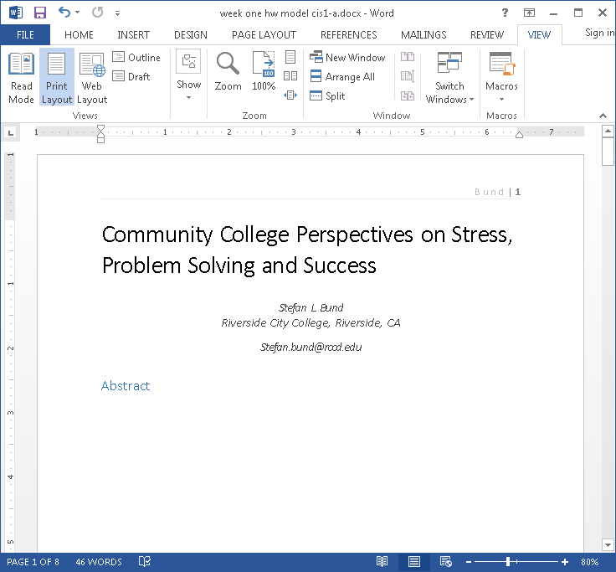
What you’re making right now
Sources document / summaries
Working final draft

